Slide 1
The Network Layer
Chapter 5

Slide 2
Internetworking
How networks differ
How networks can be connected
Tunneling
Internetwork routing
Packet fragmentation

Slide 3
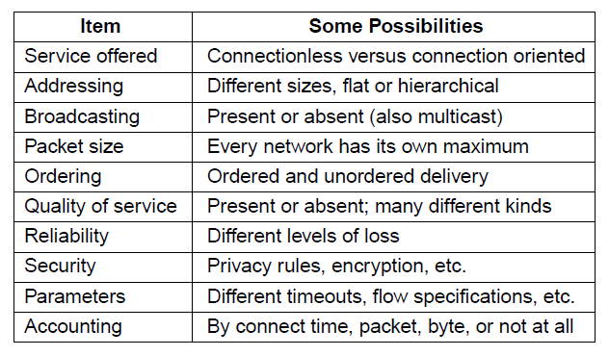
How Networks Differ
Some of the many ways networks can differ

Slide 4
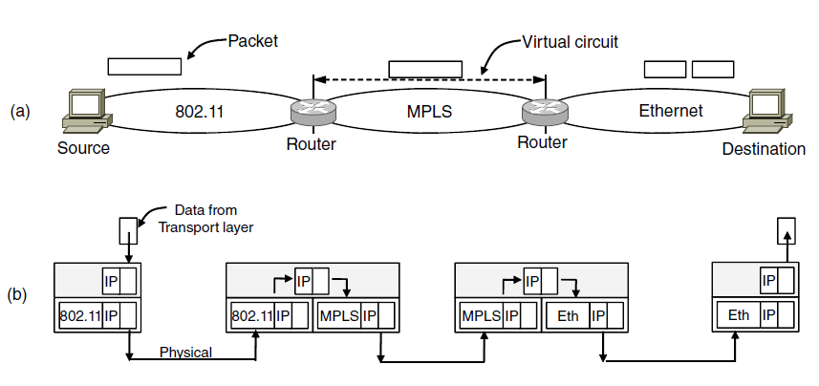
How Networks Can Be Connected
A packet crossing different networks.
Network and link layer protocol processing.

Slide 5
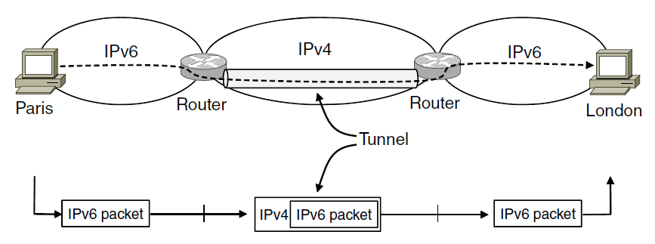
Tunneling (1)
Tunneling a packet from Paris to London.

Slide 6
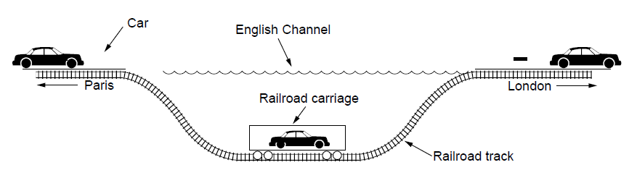
Tunneling (2)
Tunneling a car from France to England

Slide 7
Internetwork Routing
Routing through an internet poses the same basic problem as routing within a single network, but with some added complications
For example:- one network may use link state routing and another distance vector routing. Since link state algorithms need to know the topology but distance vector algorithms do not, this difference alone would make it unclear how to find the shortest paths across the internet.

Slide 8
Internetwork Routing
Interior gateway protocol (Within the network)
Exterior gateway protocol (Between the networks)
AUTONOMOUS SYSTEM(AS)
--each network in the internetwork is independent of all others.

Slide 9
Internetwork Routing
2-level routing algorithm
Within each network, an intradomain or interior gateway protocol is used for routing.
Across the networks that make up the internet, an interdomain or exterior gateway protocol is used.
The networks may all use different intradomain protocols, but they must use the same interdomain (BGP) protocol.

Slide 10
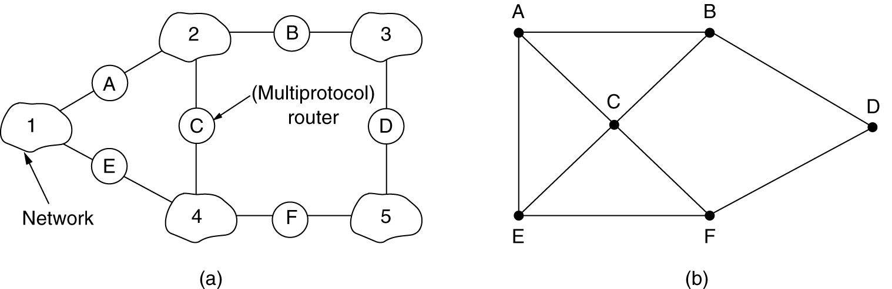
Internetwork Routing
(a) An internetwork. (b) A graph of the internetwork.

Slide 11
Packet Fragmentation (1)
Packet size issues:
Hardware (e.g., the size of an Ethernet frame).
Operating system (e.g., all buffers are 512 bytes).
Protocols (e.g., the number of bits in the packet length field).
Compliance with some (inter)national standard.
Desire to reduce error-induced retransmissions to some level.
Desire to prevent one packet from occupying the channel too long.

Slide 12
Problem:-when a large packet wants to travel through a network whose maximum packet size is too small.
MTU (Path Maximum Transmission Unit)
Allow routers to break up packets into fragments

Slide 13
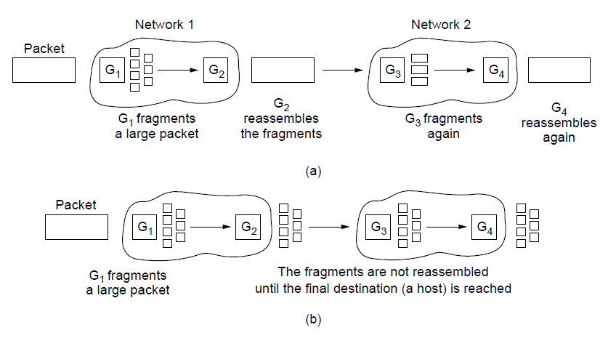
Packet Fragmentation (2)
Transparent fragmentation.
Nontransparent fragmentation

Slide 14
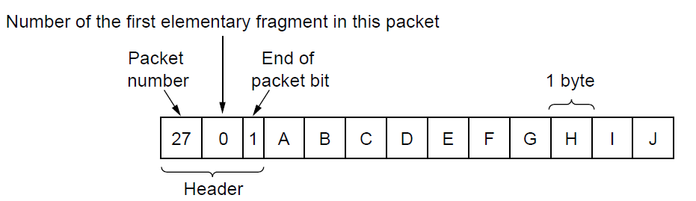
Packet Fragmentation (3)
Fragmentation when the elementary data size is 1 byte.
(a) Original packet, containing 10 data bytes.

Slide 15
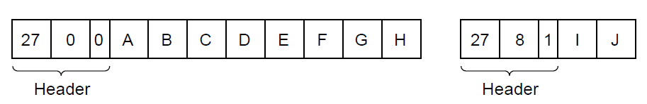
Packet Fragmentation (4)
Fragmentation when the elementary data size is 1 byte
(b) Fragments after passing through a network
with maximum packet size of 8 payload bytes plus header.

Slide 16
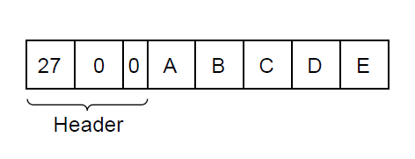
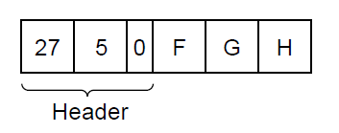
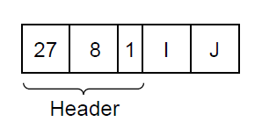
Packet Fragmentation (5)
Fragmentation when the elementary data size is 1 byte
(c) Fragments after passing through a size 5 gateway.

Slide 17
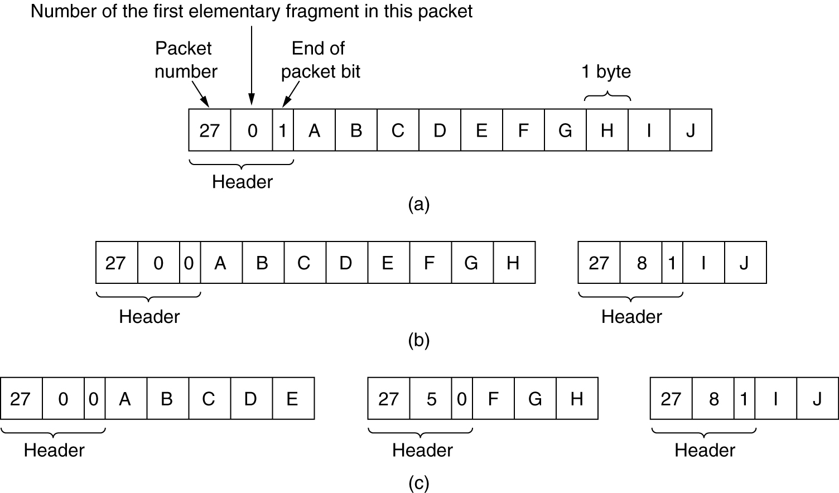
Fragmentation (2)
Fragmentation when the elementary data size is 1 byte.
(a) Original packet, containing 10 data bytes.
(b) Fragments after passing through a network with maximum packet size of 8 payload bytes plus header.
(c) Fragments after passing through a size 5 gateway.

Slide 18
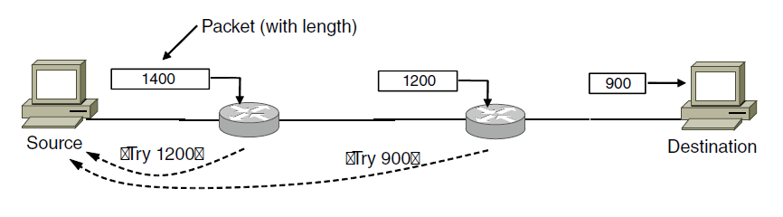
Packet Fragmentation (6)
Path MTU Discovery

Slide 19
The Network Layer Principles (1)
Make sure it works
Keep it simple
Make clear choices
Exploit modularity
Expect heterogeneity
. . .

Slide 20
The Network Layer Principles (2)
. . .
Avoid static options and parameters
Look for good design (not perfect)
Strict sending, tolerant receiving
Think about scalability
Consider performance and cost

Slide 21
The Network Layer in the Internet (1)
The IP Version 4 Protocol
IP Addresses
IP Version 6
Internet Control Protocols
Label Switching and MPLS
OSPF—An Interior Gateway Routing Protocol
BGP—The Exterior Gateway Routing Protocol
Internet Multicasting
Mobile IP

Slide 22
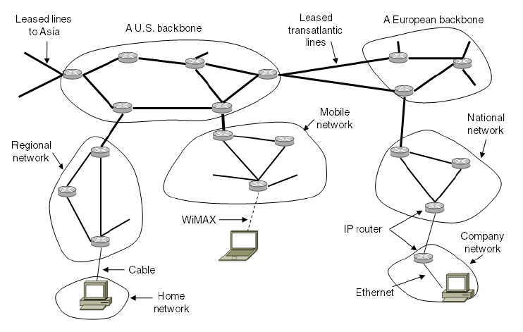
The Network Layer in the Internet (2)
The Internet is an interconnected collection of many networks.

Slide 23
IPV4 Header format
IP Header ---20 Bytes
Data --- Variable Length

Slide 24
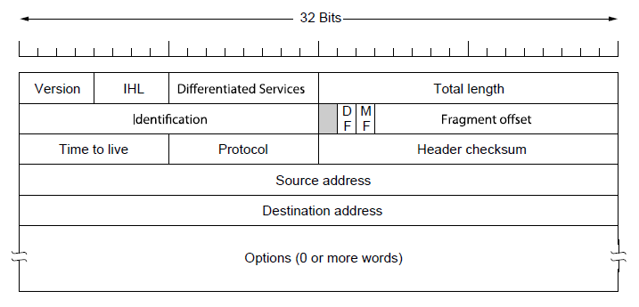
The IPv4 Header Format (1)
The IPv4 (Internet Protocol) header.

Slide 25
The IPv4 Header Format (2)
IHL (Internet Header Length)
Gives the information about length of header in 32-bit words. Normally it is (5* 32 bit words=5*4=20bytes)
The minimum value is 5, which applies when no options are present.
The maximum value of this 4-bit field is 15, which limits the header to 60 bytes, and thus the Options field to 40 bytes

Slide 26
The IPv4 Header Format (3)
Differentiated services field
Originally, it was called the Type of service field.
The Type of service field provided
3 bits to signal priority and 3 bits to signal whether a host cared more about delay, throughput, or reliability.
(the top 6 bits are used to mark the packet with its service class; we described the expedited and assured services)
The bottom 2 bits are used to carry explicit congestion notification information

Slide 27
IPV4 Header format
Total Length---16 bits
--specifies the total length of the IP datagram
--Max length is 65536 bytes
Identification– 16 bits
--needed to allow the destination host to determine which packet a newly arrived fragment belongs to
--uniquely identifies the datagram, usually incremented by 1 each time a datagram is sent.
--all the fragments have the same identification value

Slide 28
IPV4 Header format
FLAGS---
DF—do not fragment, it is request to routers not to fragment the datagram since the destination is incapable of putting the pieces back together.
MF—More fragment to follow, all fragments except the last one have this bit set. It is need to know all fragments are arrived.
Fragment Offset—13 bits
--specifies the offset, or position, in the overall message where the data in this fragment goes.
--Specified in units of 8 bytes.
--The first fragment has an offset of 0.

Slide 29
IPV4 Header format
Time to live—8 bits
-- time to live in network (in terms of router hops)
--This feature prevents packets from wandering around forever
Protocol --- 8 bits
--The Protocol field tells it which transport process to give the packet to. TCP is one possibility, but so are UDP and some others. .
0—Reserved, 1—ICMP
2—IGMP, 6—TCP
17--UDP

Slide 30
IPV4 Header format
Header checksum—16 bits
--computed over header to provide basic protection against corruption in transmission
--at each hop the devise receiving the datagram does the same checksum calculation and on a mismatch, discards the datagram as damaged.
Source address—32 bits
Destination address
Options– this field is padded out to a multiple of 4-bytes,

Slide 31
IPV4 Header format
Options–
Allow subsequent versions of the protocol to include information not present in the original design
The options are of variable length. Each begins with a 1-byte code identifying the option.
Some options are followed by a 1-byte option length field, and then one or more data bytes
This field is padded out to a multiple of 4-bytes.

Slide 32
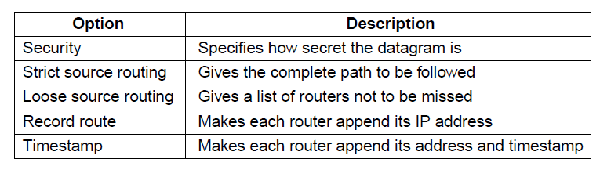
The IP Version 4 Protocol (2)
Some of the IP options.

Slide 33
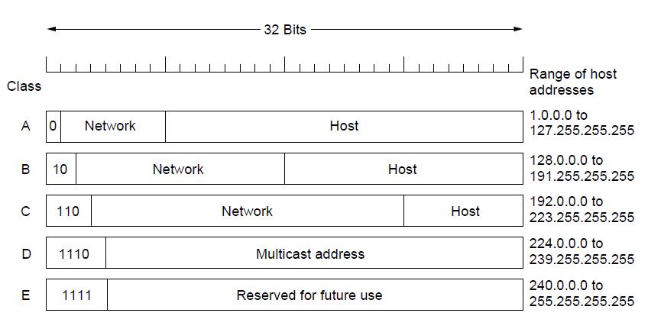
IP Addresses (6)
IP address formats

Slide 34
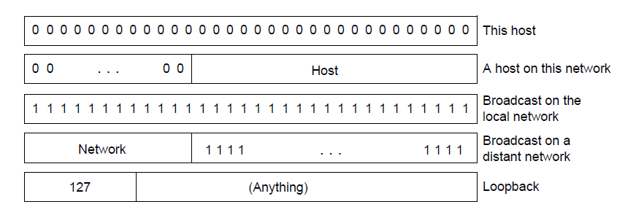
IP Addresses (7)
Special IP addresses

Slide 35
NAT—Network Address Translation
IP addresses are scarce. An ISP might have a /16 address, giving it 65,534 usable host numbers. If it has more customers than that, it has a problem.
This scarcity has led to techniques to use IP addresses sparingly. One approach is to dynamically assign an IP address to a computer when it is on and using the network, and to take the IP address back when the host becomes inactive.
The long-term solution is for the whole Internet to migrate to IPv6, which has 128-bit addresses
The quick fix that is widely used today came in the form of NAT (Network Address Translation)

Slide 36
NAT
The basic idea behind NAT is for the ISP to assign each home or business a single IP address (or at most, a small number of them) for Internet traffic.
This translation makes use of three ranges of IP addresses that have been declared as private. Networks may use them internally as they wish. The only rule is that no packets containing these addresses may appear on the Internet itself. The three reserved ranges are:
  10.0.0.0 – 10.255.255.255/8 (16,777,216 hosts)
  172.16.0.0 – 172.31.255.255/12 (1,048,576 hosts)
  192.168.0.0 – 192.168.255.255/16 (65,536 hosts)

Slide 37
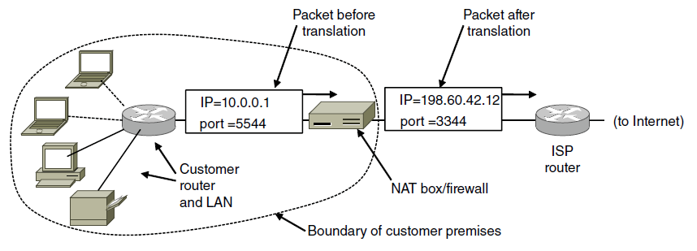
NAT
Placement and operation of a NAT box.

Slide 38
NAT - objections
First, NAT violates the architectural model of IP, which states that every IP address uniquely identifies a single machine worldwide.
Second, NAT breaks the end-to-end connectivity model of the Internet, which says that any host can send a packet to any other host at any time.
Third, NAT changes the Internet from a connectionless network to a peculiar kind of connection-oriented network.
Fourth, NAT violates the most fundamental rule of protocol layering.
Fifth, processes on the Internet are not required to use TCP or UDP.

Slide 39
IP Version 6 Goals
Support billions of hosts
Reduce routing table size
Simplify protocol
Better security
Attention to type of service
Aid multicasting
Roaming host without changing address
Allow future protocol evolution
Permit coexistence of old, new protocols. . .

Slide 40
The main features of IPv6
IPv6 has longer addresses than IPv4.
IPv6 is the simplification of the header. It contains only seven fields.
Better support for options.
IPv6 represents a big advance is in security.

Slide 41
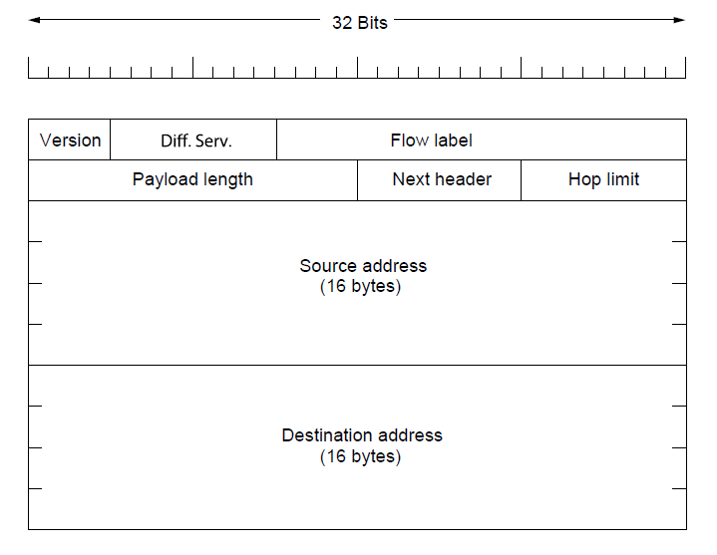
IP Version 6 (1)
The IPv6 fixed header (required).

Slide 42
IP Version 6 (2)
The Version field is always 6 for IPv6 (and 4 for IPv4).
The Differentiated services field (originally called Traffic class) is used to distinguish the class of service for packets with different real-time delivery requirements.
The Flow label field provides a way for a source and destination to mark groups of packets that have the same requirements and should be treated in the same way by the network, forming a pseudo connection.
The Payload length field tells how many bytes follow the 40-byte header

Slide 43
IP Version 6 (3)
Next header field tells which transport protocol handler (e.g., TCP, UDP) to pass the packet to
The Hop limit field is used to keep packets from living forever. It is, in practice, the same as the Time to live field in IPv4, namely, a field that is decremented on each hop

Slide 44
IP Version 6 (4)
A new notation has been devised for writing 16-byte addresses. They are written as eight groups of four hexadecimal digits with colons between the groups, like this:
8000:0000:0000:0000:0123:4567:89AB:CDEF
The above address now becomes 8000::123:4567:89AB:CDEF

Slide 45
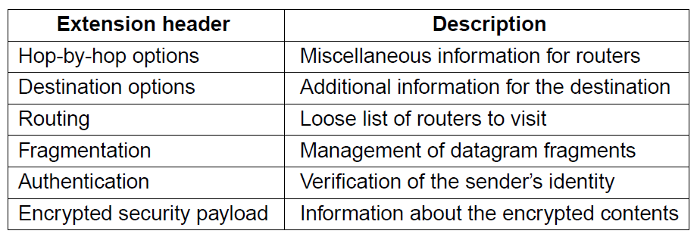
IP Version 6 (5)
IPv6 extension headers

Slide 46
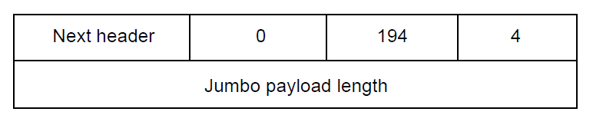
IP Version 6 (6)
The hop-by-hop extension header for
large datagrams (jumbograms).

Slide 47
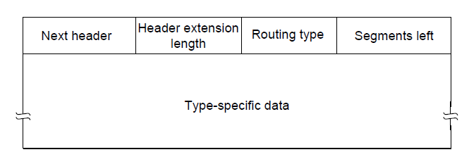
IP Version 6 (7)
The extension header for routing.

Slide 48
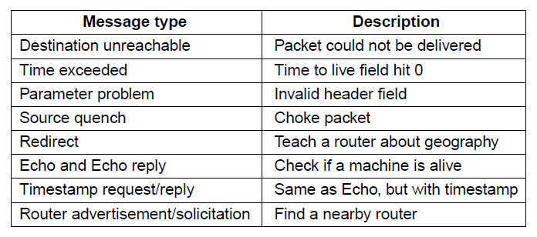
Internet Control Protocols (1)
The principal ICMP message types.

Slide 49
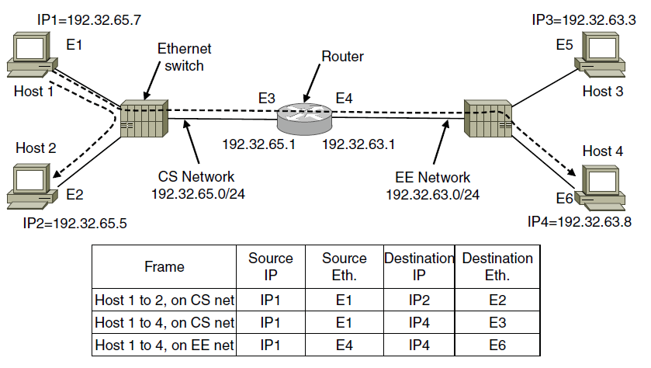
Internet Control Protocols (2)
Two switched Ethernet LANs joined by a router

Slide 50
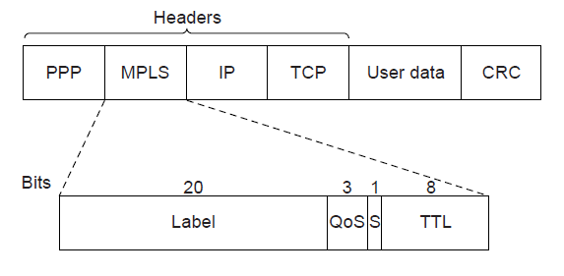
Label Switching and MPLS (1)
Transmitting a TCP segment using IP, MPLS, and PPP.

Slide 51
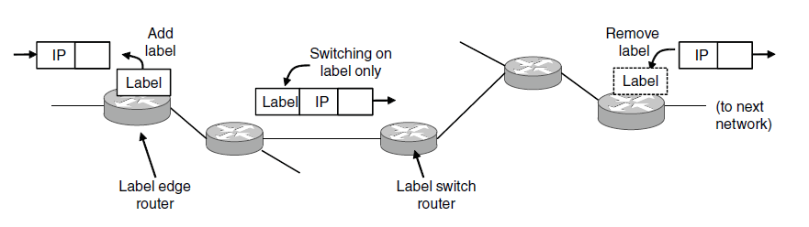
Label Switching and MPLS (2)
Forwarding an IP packet through an MPLS network

Slide 52
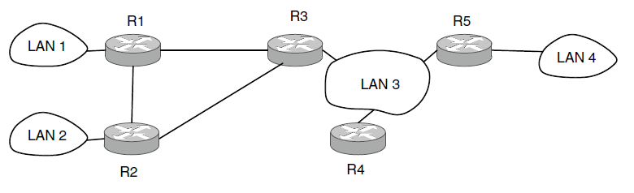
OSPF—An Interior Gateway
Routing Protocol (1)
An autonomous system

Slide 53
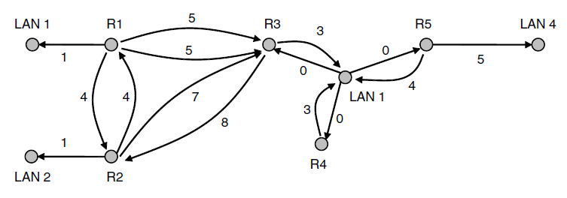
OSPF—An Interior Gateway
Routing Protocol (2)
A graph representation of the previous slide.

Slide 54
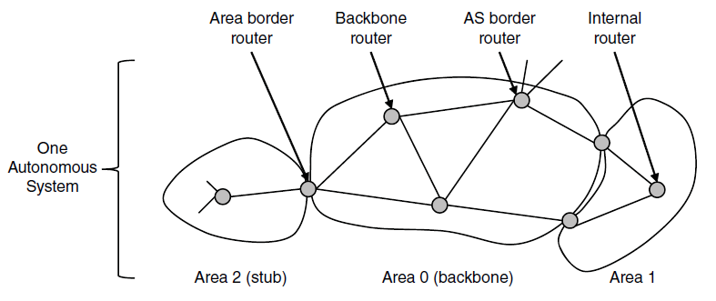
OSPF—An Interior Gateway
Routing Protocol (3)
The relation between ASes, backbones, and areas in OSPF.

Slide 55
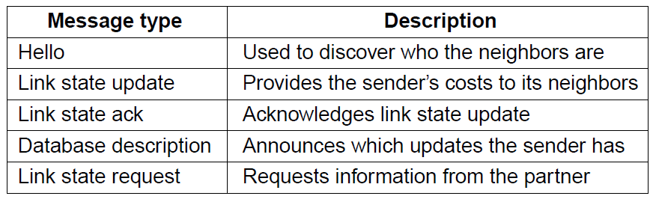
OSPF—An Interior Gateway
Routing Protocol (4)
The five types of OSPF messages

Slide 56
BGP—The Exterior Gateway
Routing Protocol (1)
Examples of routing constraints:
No commercial traffic for educat. network
Never put Iraq on route starting at Pentagon
Choose cheaper network
Choose better performing network
Don’t go from Apple to Google to Apple

Slide 57
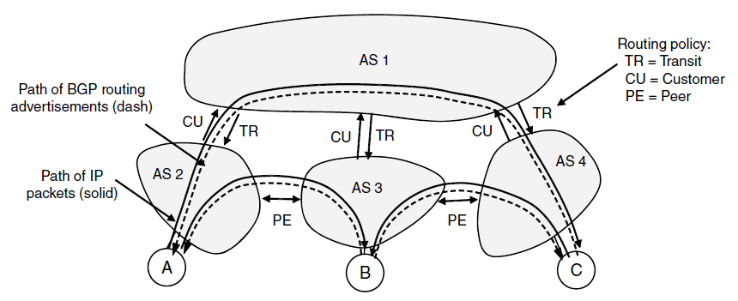
BGP—The Exterior Gateway
Routing Protocol (2)
Routing policies between four Autonomous Systems

Slide 58
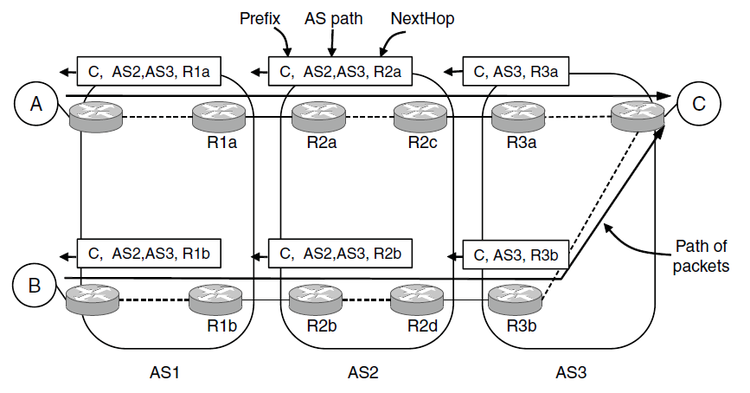
BGP—The Exterior Gateway
Routing Protocol (3)
Propagation of BGP route advertisements

Slide 59
Mobile IP
Goals
Mobile host use home IP address anywhere.
No software changes to fixed hosts
No changes to router software, tables
Packets for mobile hosts – restrict detours
No overhead for mobile host at home.

Slide 60
End
Chapter 5

